Slide 1
DOMAĆI ZADATAK

Slide 2
PODESITE UVEĆAVANJE
Notes:
Podesite uvećavanje na 110 procenata
U Sorter View prikazu, prikažite slajdove da budu veličine 40 procenata

Slide 3
PRAVLJENJE PREZENTACIJE

Slide 4
Format Textbox
Microsoft Office Specialist
Notes:
Primenite “Intense Effect – Gray 50%, Accent 6” stil na textbox (u delu Format)

Slide 5
FORMATIRANJE TEKSTA
Microsoft Office Specialist (MOS) is the credential required by academia and business, recognized globally as the premier credential chosen by individuals seeking to validate their knowledge, skills and abilities relating to the Microsoft Office applications.
In academia, MOS promotes success in the classroom for students (and instructors), builds individual distinction, and prepares students for an increasingly competitive workforce
For business, MOS maximizes office productivity and efficiency for the organization and increases job satisfaction and heightens career achievement among employees
In workforce development, MOS prepares and places job candidates, ensuring they possess the skills employers require
Notes:
Formatirajte tekst tako da bude u jednoj koloni

Slide 6
FORMATIRANJE TEKSTA
Microsoft Office Specialist (MOS) is the credential required by academia and business, recognized globally as the premier credential chosen by individuals seeking to validate their knowledge, skills and abilities relating to the Microsoft Office applications.
In academia, MOS promotes success in the classroom for students (and instructors), builds individual distinction, and prepares students for an increasingly competitive workforce
For business, MOS maximizes office productivity and efficiency for the organization and increases job satisfaction and heightens career achievement among employees
In workforce development, MOS prepares and places job candidates, ensuring they possess the skills employers require
Notes:
Izmenite da nema tačaka
Centirajte tekst da bude na sredini
Podesite razmak da bude 2.0

Slide 7
PORAVNAVANJE
Word
Excel
Access
PowerPoint
Outlook
Notes:
Poravnajte listu da bude na sredini

Slide 8
IZMENA TEME PREZENTACIJE
Notes:
Promenite temu prezentacije da bude Organic (ime teme)

Slide 9
VELIČINA SLAJDA
Notes:
Stavite da slajd bude 16:9 veličine

Slide 10

UBACIVANJE SLIKA
Ubacivanje slike u prezentaciju
Notes:
Ubacite bilo koju sliku sa interneta da bude iza teksta

Slide 11
GRAFIČKI I MULTIMEDIJALNI ELEMENTI

Slide 12
SMARTART
Word
Excel
PowerPoint
Access
Notes:
Napravite SmartArt dijagram da bude ciklično prikazan i zamenite reč Outlook sa Access

Slide 13

FormatIRANJE Audio ZAPISA
Notes:
Izmenite audio klip tako da se automatski reprodukuje

Slide 14
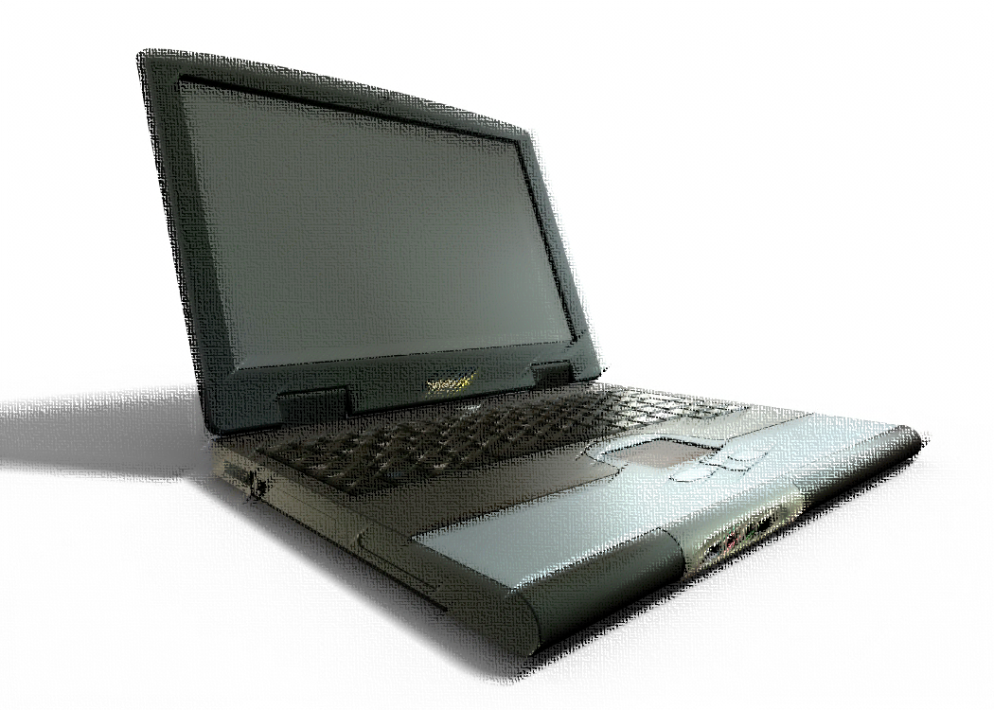
FormatIRANJE SLIKA
Notes:
Dodajte umetničke efekte slici Pastels Smooth

Slide 15

SLIKE
Notes:
Rotirajte sliku za 90 stepeni u desno

Slide 16
GRAFIKONI

Slide 17
Stil grafikona
Notes:
Promenite stil grafikona da bude Combo sa Series 3 na sekundarnoj osi

Slide 18
TIP GRAFIKONA
Notes:
Promenite grafikon u Pie

Slide 19
ANIMACIJE I TRANZICIJE

Slide 20
Uvodna animacija
Word
Excel
Access
PowerPoint
Outlook
Notes:
Primenite “Split” animaciju na teze
Spojite Word i Excel da se prikazuju prvo pa zatim Access, PowerPoint i Outlook

Slide 21
DOSTAVLJANJE PREZENTACIJE

Slide 22
PowerPoint Show
Notes:
Sačuvajte prezentaciju pod nazivom Prezentacija

Slide 23
PREGLEDANJE PREZENTACIJE
Notes:
Pogledajte prezentaciju kao slide show.

