Slide 1
Meetings in English

Slide 2
Meetings
frequent/ regular
annual/ monthly/quarterly/weekly
all-day/ breakfast/ weekend
formal/ informal
open/ closed
public/ private/ secret
face-to-face/ personal/ on-line
bilateral/ trilateral
high-level/ top-level
departmental/ staff/ team/ union
have
attend/ invite people to attend
participate in
arrange/ schedule/ organize
manage/ hold
host/ chair/ conduct
open/ declare open
close/ declare closed
call off/ cancel
Postpone
Ban
boycott

Slide 3
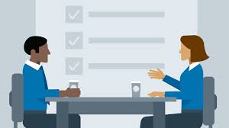
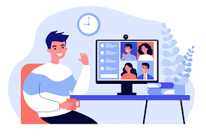

1. Before a meeting

Slide 4
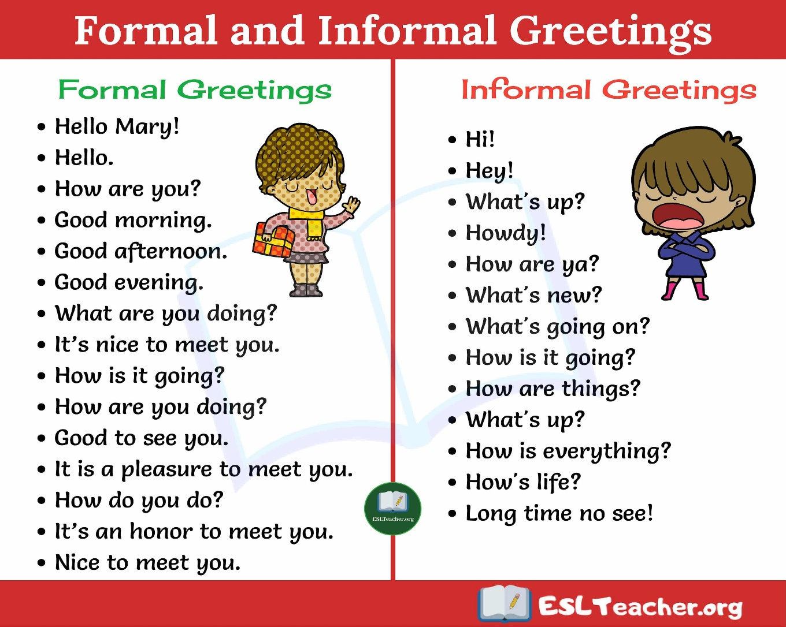
Meeting and greeting

Slide 5
Small talk phrases- examples
1. What are you working on at the moment?
2. How is it going with your new assistant?
3. Are you making any progress with your big project?
4. How did your presentation go last week?
5. How was your business trip? When did you get back?
6. What’s new?
7. Have you heard back from that potential big customer yet?
8. What have you been up to in your department?
9. When do you think they will finally sign the contract?
10. Are you going to the conference this weekend?

Slide 6
Present tenses
Present simple
Present continuous
General time:
Alice works for an insurance company.
They have meetings every Friday.
What do frogs eat?
It always rains here in November.
Talking about the future
for timetabled future events:
I start my new job tomorrow.
In subordinate clauses:
I will phone you when I get home.( NOT when I will get home)
Use around now
What are you doing? I am writing a letter.
He is working in Italy at the moment.
Repeated actions if these are just happening around the present
I am travelling a lot these days.
Talking about the future
What are you doing tomorrow evening?
We use perfect, not present tenses to say how long a present action has been going on.
I’ve known her since 1990.
I’ve been learning English for three years.

Slide 7



2. Participation in a meeting

Slide 8
Types of users of English
Perfectionists
Risk-takers

Slide 9
Strategies for perfectionists
Learn a few “interrupting phrases” like:
Can I just say something?
Can I just stop you for a second?
Sorry to interrupt, but....
The best one-word interrupting phrase is But ..., or you could simply say the person’s name.
Learn hundreds of new words.
Go for it!

Slide 10
Strategies for perfectionist
Learn some phrases for checking understanding:
What exactly do you mean by…?
Sorry – I didn’t catch that last word.
Can I just check if I understood you correctly?
I’m not familiar with the abbreviation R. Can someone help me?
OK, I understood almost everything, but not the last bit. What are we voting on now?
Sorry, but could you speak up a little. It’s difficult to hear you.
Would you mind speaking a bit slowly, please? I’m having trouble keeping up.

Slide 11
Strategies for risk-takers
Record yourself speaking at a meeting in English.
Ask a colleague what bad habits you have with English grammar or pronunciation.

Slide 12
Strategies for risk-takers
involve less confident colleagues
Do you think…?
What about if we…?
Why don’t we…?
That would work, wouldn’t it?
After you.
Go on.
Sorry, I interrupted you. You were saying…
Sorry, you were about to say something and I cut you off.

Slide 13
Phrases for preventing interruptions
Can I just finish my point?
Hang on a second, can you let me finish?
I’m sorry, but this is really important.
I’ll let you speak in a second.

Slide 14
Giving your opinion
make
a point
a proposal
a suggestion
raise
an issue
an objection
a point
give/state
your opinion
your view
May I make a suggestion to the chairman of the board?
The workers raised an objection to longer working hours.
He invited the committee members to give their opinion.

Slide 15
Past forms
Past continuous
We use it to say that something was in progress around a particular past time.
When I got up this morning, the sun was shining, the birds were singing…
We use it to show an action that was in progress when another action occurred.
They were preparing the accounts when the computer crashed.
At the time when it happened, I was travelling to Belgrade.
We use it to show two or more actions were in progress at the same time.
While we were packing the boxes they were writing the labels.
Past perfect
Earlier past: When we arrived, the meeting had already started.
How long? When they got married, they had known each other for 15 years.
Past simple (‘normal’ for talking about the past)
We use it to describe:
A single past action or a series of completed past actions.
He signed the invoice, put it into an envelope and posted it.
We use past simple for many kinds of past events ( short, quickly finished actions, longer situations, repeated events)
Peter broke a window last night.
I spent all my childhood in Spain.
Regularly every summer, John fell in love.
One day she decided that she didn’t like staying at home, so she told her husband that she wanted to get a job.

Slide 16


3. Managing a meeting

Slide 17
Planning a meeting
whether a meeting needs to take place
how it should take place (e.g. face-to-face, by teleconference)
where and when it should take place
who needs to attend
how long it should last
what it should achieve
how much preparation each participant should do beforehand, etc.

Slide 18
Arranging a meeting
informing the participants about the purpose of and background of the meeting
persuading them why the meeting is important
negotiating time and place, making sure everyone knows how to prepare, etc.
call the meeting
invite people to attend the meeting
draw up an agenda
circulate an agenda
approve/ agree the minutes of the previous meeting
agree on the agenda for the current meeting
add an item to the agenda
remove something from the agenda
take/leave something off the agenda

Slide 19
Useful phrases used in emails
Referring to previous knowledge or conversations:
As you may know, we are developing a major new project.
Based on the information I received, I would like to invite you to our first meeting.
Please make sure you have read the briefing documents that I sent on Monday.
As promised, I am attaching the meeting minutes.
As we discussed, our next meeting will be on 21st April.
Referring to attachments:
I am attaching a short summary of the project for your information.
I’m attaching some background documents, so you can familiarize yourself with the project aims and scope.
Attached again for your reference…

Slide 20
Useful phrases used in emails
Explaining reasons:
In order for the project to be successful we need support from all departments.
With this in mind, I would like to set up the project team.
I believe this project will be useful for individual members as they will gain a better understanding.
Could you let me know your availability, so I can find time that suits most people?
Explaining what you want to do:
We need to get the input and support from as many departments as possible.
I’d like to make a proposal.
I’ll email people individually about specific action points.
Showing understanding:
I realize this is a busy time of year for many departments, but I would like to stress that this project is of vital importance to the future growth of our organization.
Emphasizing key information or benefits:
I believe membership of the team will also be beneficial for individual members.
I’d like to stress that this is only a small survey.
This information is of vital importance.
Please check the meeting minutes carefully especially the list of action points at the end.

Slide 21
Useful phrases used in emails
Expressing enthusiasm:
Welcome to the meeting.
I’m very excited about the new project.
I’m convinced that this will be a tremendous success.
I think the meeting was incredibly productive, and your contributions and ideas were extremely valuable.
Making suggestions:
some time next week
as early as possible
preferably
ideally
Explaining practical details:
The first meeting should last no more than one hour.
Coffee and biscuits will be provided.
As we discussed our next meeting will be on 3rd June.
I’ll be in touch closer to that date with an agenda for that meeting.
Expressing thanks:
Many thanks.
Thanks a lot.
Thanks to everyone who came to our first meeting yesterday.
Thanks again for all your support.

Slide 22
Managing a meeting
getting the meeting started
explaining the procedures and your expectations
managing the stages of the meeting
making sure everyone in fully involved
keeping the discussion focused
dealing with unexpected problems
making sure decisions are taken and recorded
closing the meeting effectively
following up the meeting by email, etc.

Slide 23
Getting the meeting started
9 steps of the meeting introduction
getting people’s attention, interrupting small talk
dealing with non-attendees
stating the purpose
stating the desired outcome
checking if people have seen the agenda
explaining time limits and procedures
dealing with a late arrival
introducing the first point on the agenda
handing over to the first speaker
1. I think we should start now. Robert, Alex ... could you ...? Robert...? Thanks.
2. OK, so, is everybody here? Who are we waiting for? Well, I think we’ll have to make a start without them. We’ve got a lot to get through this afternoon.
3. As you know, the purpose of today’s meeting is to see where we are with the marketing plan, and to work out what we still need to do before the launch.
4. By the end of the meeting, we need to have a list of firm action points for the next month. Hopefully we’ll then need only one more meeting next month to tie up any remaining loose ends.
5. Did everyone get a copy of the agenda I sent round?
6. We have got a lot to get through, so please let’s stick to the agenda. I’ve set aside two hours for this meeting, and we really can’t afford to run over. Ideally, we can cover everything in an hour and a half. Does that sound reasonable?
7. Ah, Helena, come and take a seat. We started without you.
8. So perhaps we can get the ball rolling by going through the list of action points from the last meeting.
9. Michael, you were going to look into the costs of the various options that came up last time. Could you tell us what you found out?

Slide 24
Useful phrases for managing a meeting
Welcoming and thanking:
OK, so let me start by welcoming you all to our first meeting.
Thanks a lot for volunteering to join the team, and thanks also for coming.
Your support is very much appreciated.
That would be really useful, thanks.
Signaling different stages of the meeting:
I’m going to begin with a brief presentation now on the background of the project.
Right. So that brings me to the end of the presentation.
Are there any questions? OK, so if nobody has any more questions at this stage, I’d like to move on to the next point on the agenda, which is a brainstorming session.

Slide 25
Useful phrases for managing a meeting
Avoiding trying to deal with two or more points at once:
Well, that’s really two questions.
I’ll come back to your question in a moment.
OK, so let’s take them one at a time.
Asking somebody to be more specific:
What exactly is it that you’re worried about?
What would you say are the main issues related to the marketing?
Dealing with interruptions:
OK, that’s great to hear, but I’m not sure that’s what she is worried about.
OK, can you let him finish, please?
Checking whether you’ve understood:
Do you think the project isn’t interesting enough, or that only a small number will be interested?
So you’re saying we need to give more thought to the marketing side of the things rather than changing the project itself?

Slide 26
Useful phrases for managing a meeting
Summarizing:
Great, well, we’ve had lots of good ideas already, and I’ve got pages of really useful notes.
Keeping the meeting focused on the agenda:
Well, hang on a second, I don’t think we should be going into this much detail at this stage.
Remember, we’ve only got an hour today. Perhaps we can come back to identifying very specific recommendations at our next meeting.
Prompting people to get involved, especially people who don’t want to speak:
But I want to come back to something you said earlier; you said you were worried about costs?
Are you sure? Do you think we will have problems with the supplier?
You’ve been very quiet. Do you have anything to add? Really? I was hoping you might be able to say something about the policy implementation.

Slide 27
Future forms
Present simple
We use it to talk about schedules and timetables.
The next flight to Rome leaves in half an hour.
I start my new job tomorrow.
In subordinate clauses that refer to the future
I’ll phone you when I get to the office.
Present continuous
We use it to talk about personal plans and arrangements, particularly when we know the time and place.
She is leaving for Madrid in the next few days.
What are you doing tomorrow evening?

Slide 28
Future forms
Future simple (will)
We use will for facts and predictions.
Production of the new model will begin in November.
More and more countries will tie their currencies to the US dollar.
we use it for promises, threats, decisions, instructions, offers
The phone is ringing. I’ll answer it.
I will stop smoking!
I’ll hit you of you do that again.
Be going to
To talk about things we plan to do, or have planned to do.
We are going to expand our overseas operation next year.
To make predictions based on what we can see now.
Just look at these sales figures! We are going to make a loss this year.

Slide 29
Future forms
Future continuous
We use it to describe actions that will be in progress at a time in the future.
Don’t worry! I’ll be waiting for you at the airport.
This time tomorrow I’ll be reading his letter.
Future perfect
To describe something that will have happened by a point in the future.
We will have had our millionth passenger by December.
I will have spent all my holiday money by the end of the week.

Slide 30


4. Brainstorming and evaluation ideas

Slide 31
Useful phrases for making suggestions
This might sound crazy, but I would like to suggest…
I am just thinking aloud for a moment, but what about…
I’ve just had an idea.
It probably wouldn’t work in practice, but ...
I haven’t thought this through yet, but...
You’ve just reminded me of something…
Just to build on that idea, ...
I wonder if we could combine your idea with something that was said earlier.
In an ideal world,...
Why don’t we ...?
I suppose we could ...
How about ...?
I think we should ...
We could always ...
I don’t suppose we could ...
Wouldn’t it be nice if we ...?
What if we ...?
I wonder if it would be possible to ...
It might be possible to ...
Could we ...?

Slide 32
Useful phrases for evaluating ideas
I don’t think it would work.
That’s a brilliant idea.
It might just work.
Absolutely.
Maybe. I’m not sure.
No, I don’t think so.
I’m not keen at all.
I’m not really convinced.
I think it needs a lot more thought.
That’s not a bad idea.
Yes, I think you’re right.
Are you sure?
I’m really not happy about it.
Well, I agree up to a point.
Well, yes and no.
This idea has potential, but it’s not quite there yet.
I think this is just what we need.
.

Slide 33

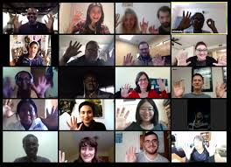
5. Closing a meeting

Slide 34
What must always happen by the end of a meeting?
clear focus on what has been agreed, and specifically what actions are going to be taken
thanking participants, giving them a final chance to ask questions or raise issues not on the agenda
formally closing the meeting so that participants know they can leave
close the meeting
bring the meeting to a close
The chairman brought the meeting to a close by thanking all those who had attended.
declare the meeting closed
The High Commissioner declared the meeting closed.
write up/circulate the minutes

Slide 35
Closing a meeting
Is there anything else we need to discuss at this stage?
OK, so I just want to go through the list of Action Points.
I suppose we could fix a time and date for that meeting now. How about making it exactly a month from now? That’s Wednesday the 11th at 10 o’clock. Is that OK?
So are there any final questions?
OK, so thank you all very much. I think we’ve had a really productive meeting.
Thanks again everybody, and have a nice day.
AOB (any other business)
Summarize the action points
Plan the next meeting
Invite final questions
Thank people
Signal that people can leave

Slide 36
Useful phrases for volunteering and delegating
Accepting
• Sure, no problem.
• OK, that’s fine.
• OK, that’s a good point.
• OK, fair enough.
• Yes, that would be great.
• Great. That would be really useful.
• Yes, of course.

Slide 37
Useful phrases for volunteering and delegating
Volunteering to help
• I’ll be seeing some of the clients, so I’ll ask them about it when I see them.
• Yes, I can do that. I’ll make a start today.
• I mean, would you like me to speak to Annie about the project?
• Would you like me to organize a staff survey?
• We can have a quick meeting tomorrow morning, if you like.

Slide 38
Useful phrases for volunteering and delegating
Instructing and setting deadlines
• Well, could you send them an email instead?
• I’d really prefer not to have to wait several weeks.
• I think we’d need an answer in good time for next month’s meeting, where I’d like you to report back on your findings.

Slide 39
Useful phrases for volunteering and delegating
Asking for clarification and advice
• What exactly do you want me to ask in my email?
• OK, so can I pick your brains at some stage on exactly how to word the survey?
Making an excuse
• Well, I could, but I’m really busy at the moment with my regular work.
• Don’t forget, I don’t have any hours allocated to this project.

Slide 40
Modal verbs
Can
To talk about general abilities:
He can speak three languages fluently.
To ask for permission:
Can I use your phone?
To make simple requests:
Can you take me to the station?
Could
To talk about general past abilities:
In the old days, a skilled worker could produce two shirts a day.
To discuss possibilities and options:
We could try changing the colour of the packaging.
To make more polite or formal requests or offers:
Could you speak a little more slowly, please?

Slide 41
Modal verbs
Must
For orders we give to ourselves:
I must send in my tax form, otherwise I’ll get a fine.
For a strong prohibition or rule:
You mustn’t smoke anywhere in the building?
For a strong recommendation:
You must see that film, it’s brilliant?
have to
To talk about duties and responsibilities:
When visitors come, I have to check their ID.
To indicate an absence of obligation or necessity:
You don’t have to take notes.
In questions:
Do I have to wear a uniform?

Slide 42
Modal verbs
May
To express possibility:
He may arrive ten minutes late today.
To ask for permission(more polite than can):
May I ask a question?
Might
Past form of may.
In present to speculate or express a more remote possibility than may:
You might have some trouble clearing these goods through customs.
To ask a polite question or make a request:
Might I make a suggestion here?

Slide 43
Modal verbs
Will
To express the future and make predictions.
To make a spontaneous offer or decision.
To make a request/ give an order.
Would
To make requests or give polite orders.
Would you bring me the bill, please?
To describe past habits.
After work he would (used to) sit down and read the newspaper.

Slide 44
Modal verbs
Should
To give advice.
At an interview, you should wear clothes you feel comfortable in.
To talk about what we think is morally right and correct.
We should help those less fortunate than ourselves.
To criticize past actions.
You should have checked their bank account before signing the contract.
You shouldn’t have let them in without a written permission.
Need
We use needn’t to say that something is not necessary.
You needn’t buy any tools, the company provides everything.
Need can also be used as a full verb:
You don’t need to by any tools.

Slide 45
Practical English usage/common mistakes
Don’t say/ write
I promise I pay you tomorrow.
This is the first time I am here.
I’ve been here since three months.
If I’ll have time, I will finish this today.
He said me that he was Italian.
He told me that he is Italian.
Say/ write
I promise I’ll pay you tomorrow.
This is the first time I’ve been here.
I’ve been here for three months.
If I have time, I will finish this today.
He told me that he was Italian.
He told me that he was Italian.

Slide 46
Practical English usage/common mistakes
Don’t say/ write
I look forward to see you.
I’m boring in this lessons.
He has much money.
Can you give me an information?
She is married with a doctor.
My brother has got a new work.
Say/ write
I look forward to seeing you.
I’m bored in this lessons.
He has a lot of/ plenty of money.
Can you give me some information?
She is married to a doctor.
My brother has got a new job.

